Slide 1

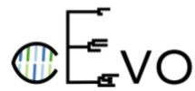



Behind the statistics: correlation decay and role of individual phylogenetic pairs in estimating the heritability of HIV virulence
Venelin Mitov and prof. Tanja Stadler, in collaboration with the Swiss HIV Cohort Study (SHCS) and the United Kingdom Drug Resistance Database (UKDRDB)

Slide 2
Agenda
Definition
Methods
Results from UKDRDB subtype B data
New Results
A toy model of an epidemic
Software

Slide 3
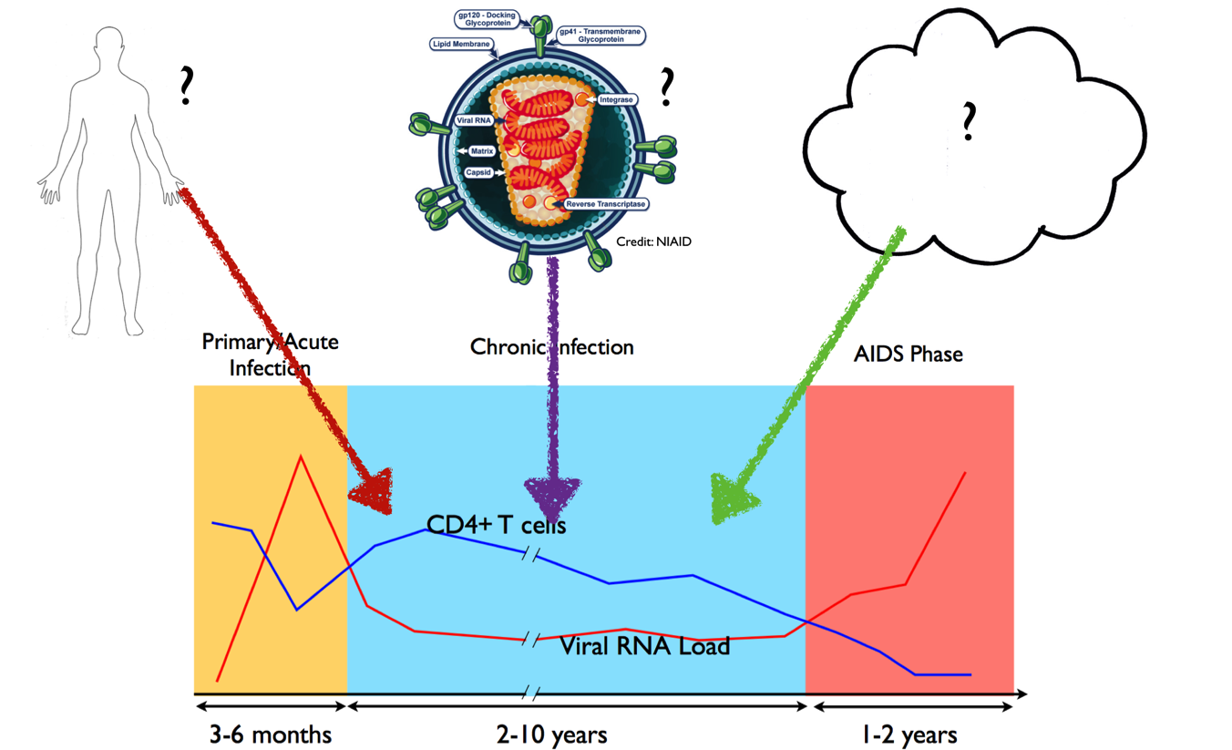
Virulence of an HIV-1 Infection
Courtesy: (Simon and Ho 2003)
“Virulence” is the inverse time to AIDS of a patient.
The viral load during the chronic phase, known as set-point viral load (spVL) provides a proxy measure for virulence.
Notes:
This is the lifecycle of an HIV-1 infection.
In red is shown the amount virions per unit volume of blood of the patient, in blue the amount of CD4 T immune cells of the patient.
The infection begins with an acute phase with a peak viral load. This phase lasts for several months, and is followed by a chronic infection phase, during which the viral load stabilizes around a level known as the viral load set point and remains relatively constant until either the patient gets diagnosed and undergoes anti-retroviral therapy or the patient develop AIDS and dies. The virulence, by definition, is the virus induced mortality rate of the patient, that is the inverse of the time between infection and AIDS. It has been confirmed that virulence correlates positively with set point viral load. Thus, set-point viral load is often regarded as a proxy for virulence.

Slide 4
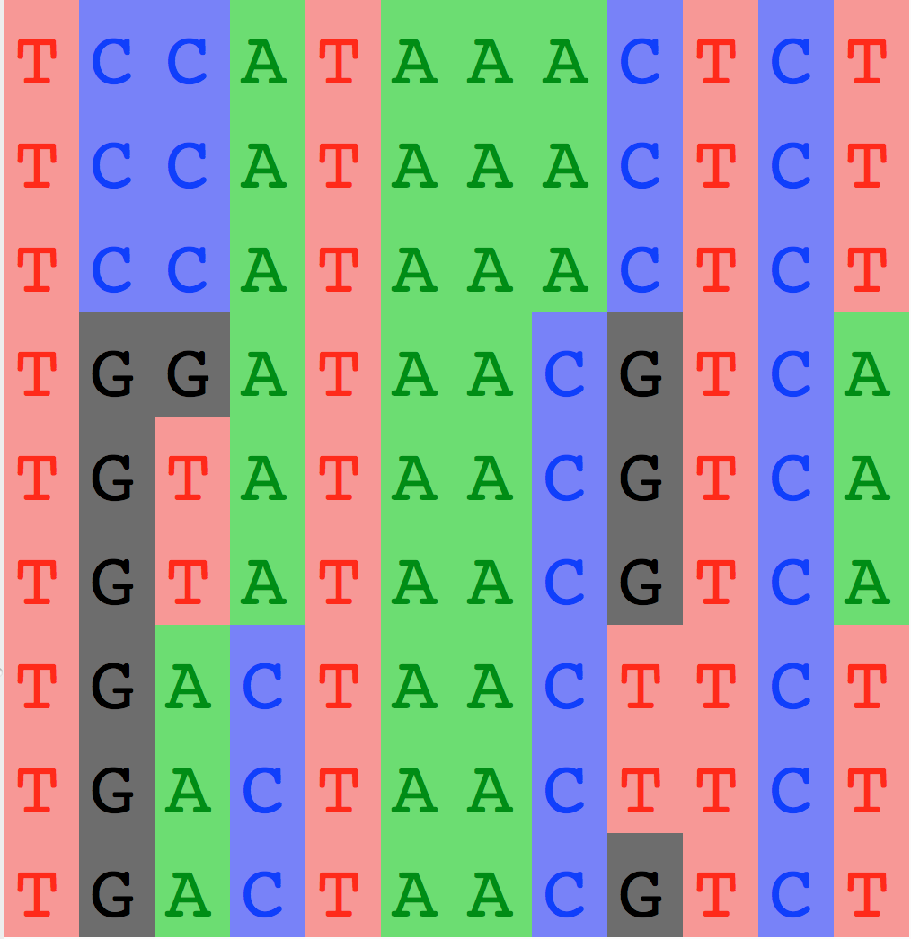
Broad-sense Heritability
Quantitative Trait Loci
Phenotypic value
Genotypic value
Z
G
…
…
4.0
4.4 4.4 4.4
…
…
4.4
…
…
4.8
…
…
3.0
3.4 3.4
3.4
…
…
3.4
…
…
3.8
…
…
2.0
2.4
2.4
2.4
…
…
2.4
…
…
2.8
Notes:
The broad-sense heritability is used to quantify the virus contribution to virulence. Imagine that we have collected SPVL-measurements and consensus viral sequences from 9 patients. <click> If, we would know which loci in the viral genotype have a deterministic role for SPVL, we could group these observations based on sequence identity at these specific loci, then define the genotypic values as the group means. The ratio of genotypic over total trait variance gives the broad-sense heritability, that is the proportion of variance in the phenotype that can be explained by the viral genetic variation.

Slide 5
Broad-sense Heritability
Z (lg(SPVL))
…
…
4.0
…
…
4.4
…
…
4.8
…
…
3.0
…
…
3.4
…
…
3.8
…
…
2.0
…
…
2.4
…
…
2.8
Are there Quantitative Trait Loci for SPVL in the HIV genome?
Notes:
However, in reality, we don’t know where the quantitative trait loci are. Moreover, we don’t know if such loci exist at all.

Slide 6
Agenda
Definition
Methods
Results from UKDRDB subtype B data
New Results
A toy model of an epidemic
Software

Slide 7
Sexual organisms ➔Pathogens
An idea from quantitative genetics
Traits of sexually reproducing organisms
The heritability of a trait in a mating population can be estimated from measures of the resemblance between relatives, e.g. regression slope of child on parent trait values.
Transfer to Pathogen traits
The heritability of a pathogen trait can be estimated from measures of the resemblance between transmission partners, e.g. regression slope of recipient on donor trait values.

Slide 8
Three differences between pathogens and sexual species
Clonal transmission vs sexual reproduction;
Quasispecies vs single genotype; Transmission bottleneck;
Within-host pathogen mutation vs germ-line mutation.
=> Unlike parent-child couples, for which the amount of genetic overlap is a known constant, i.e. 50%, the genetic overlap between the two quasispecies in a donor-recipient couple is an unknown variable.
=> Most recent studies estimate the correlation between phylogenetic pairs at 0-phylogenetic distance.

Slide 9
Two approaches

Slide 10
Approach 1: Filter the data to minimize measurement delay
Select phylogenetic pairs (PP)
Measure the correlation between 1st and 2nd value (assigning 1st and 2nd at random in each pair).
Viral sequences
Z
1
ACGAG…AT
1.2
M
2
GTAAG…AG
2.5
M
3
GTTTG…GG
1.3
M
D
4
GTGGG…GG
4.8
M
5
GTAAA…TG
2.7
M
Mitov, V. and Stadler, T. (2018) Mol Biol Evol.

Slide 11
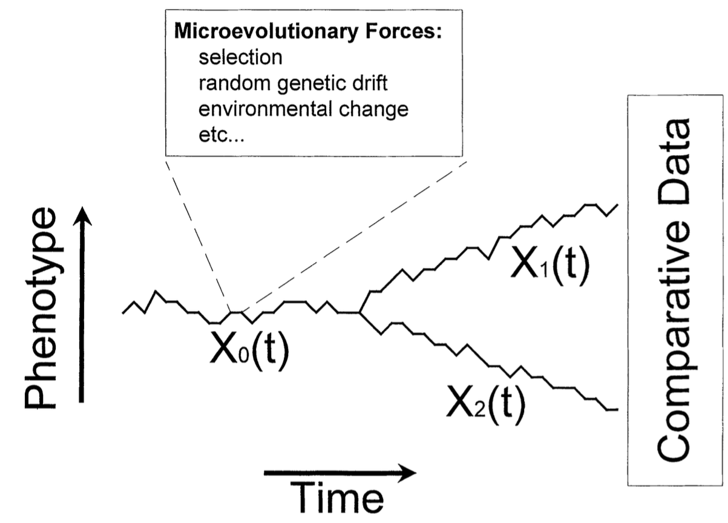
Approach 2: Phylogenetic mixed models
Assume that G evolves along the transmission tree according to a branching stochastic process, e.g. Brownian motion (BM) or Ornstein-Uhlenbeck (OU).
G₂(t)
G₀(t)
G₁(t)
Hansen, T. and Martins, E. (1996) Evolution

Slide 12
Approach 2: Phylogenetic mixed models
G₂(t)
G₀(t)
G₁(t)
Hansen, T. and Martins, E. (1996) Evolution
2. Assume that the phenotype Z is formed by adding to G an independent non-heritable component, e:
3. Estimate the broad-sense heritability as:

Slide 13
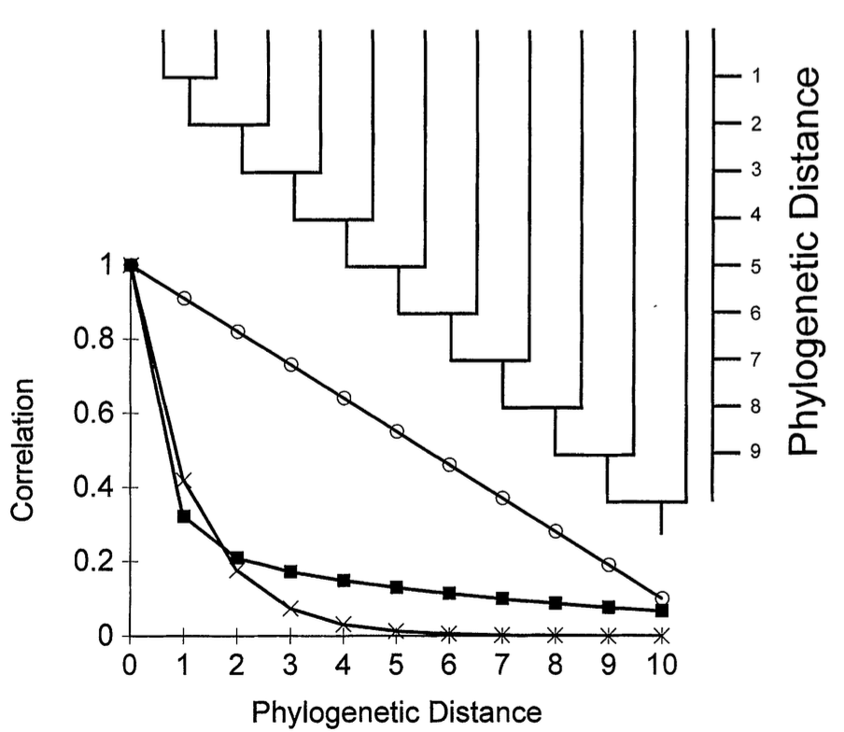
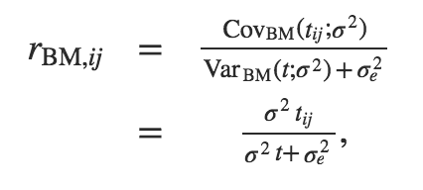
Approach 2: Phylogenetic mixed models
G₂(t)
G₀(t)
G₁(t)
Hansen, T. and Martins, E. (1996) Evolution
Hansen, T. and Martins, E. (1996) Evolution
4. Correlation decay under BM

Slide 14
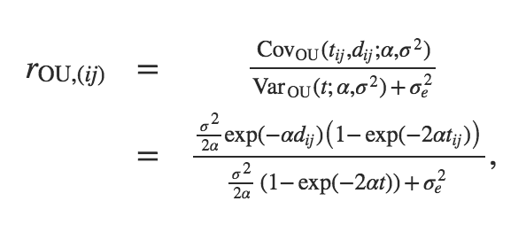
Approach 2: Phylogenetic mixed models
G₂(t)
G₀(t)
G₁(t)
Hansen, T. and Martins, E. (1996) Evolution
Hansen, T. and Martins, E. (1996) Evolution
5. Correlation decay under OU

Slide 15
Agenda
Definition
Methods
Results from UKDRDB subtype B data
New Results
A toy model of an epidemic
Software

Slide 16
Data from the UK DRDB Cohort study (Hodcroft et al. 2014)
A RAxML-inferred transmission tree including 8,486 subtype B treatment-naïve pol sequences,
Liberal spVL definition;

Slide 17
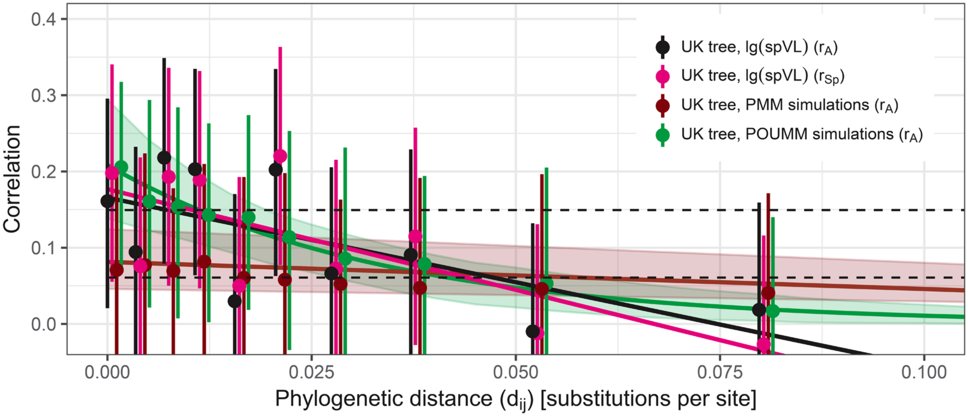
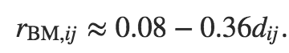
The correlation in PPs tends to decrease with phylogenetic distance.
Mitov & Stadler 2018, MBE
Under BM the correlation decay approximates a linear decay:

Slide 18
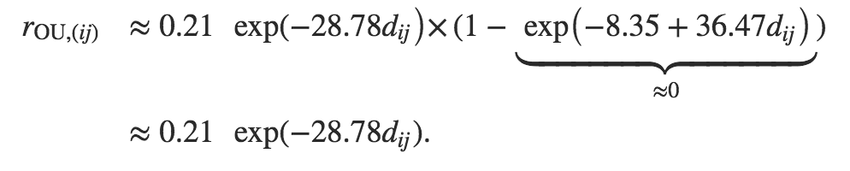
The correlation in PPs tends to decrease with phylogenetic distance.
Mitov & Stadler 2018, MBE
Under OU the correlation decay approximates an exponential decay:

Slide 19
Mitov & Stadler 2018, MBE

Slide 20
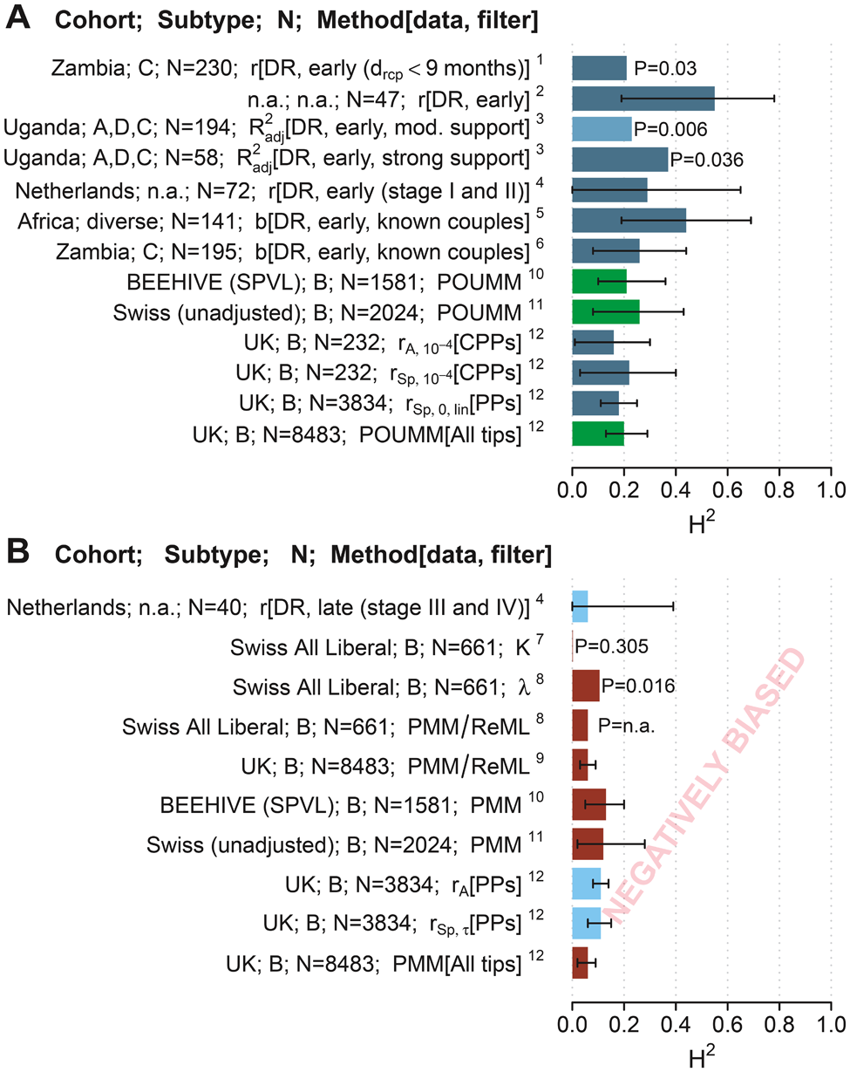
Reference key:
1: Tang et al. (2004);
2: Hecht et al. (2010);
3: Hollingsworth et al. (2010);
4: van der Kuyl et al. (2010);
5: Lingappa et al. (2013);
6: Yue et al. (2013);
7: Alizon et al. (2010);
8: Shirreff et al. (2013);
9: Hodcroft et al. (2014);
10: Blanquart et al. (2017);
11: Bertels et al. (2017);
12: Mitov & Stadler (2018).
Mitov & Stadler 2018, MBE

Slide 21
Agenda
Definition
Methods
Results from UKDRDB subtype B data
New Results
A toy model of an epidemic
Software

Slide 22
UKDRDB and SHCS data
UK Drug Resistance Database (UKDRDB)
Viral load and sequence data from 13,861 treatment-naïve patients;
Total of 82,396 viral load (VL) measures (median of 4 VL per patient)
Total of 17,451 consensus pol-sequences (median of 1 sequence per patient)
Subtypes A_A1, B, C, CRF02_AG
Swiss HIV Cohort Study (SHCS)
Viral load and sequence data from about 6,000 treatment-naïve patients;
Total of about 20,000 viral load (VL) measures (median of 4 VL per patient)
Total of about 10,000 consensus pol-sequences (median of 1 sequence per patient)
Subtypes A_A1, B, C, CRF02_AE

Slide 23
Pipeline
Data-source:
SHCS
UKDRDB
Definition of spVL:
Liberal (Hodcroft 2014);
Strict (Fellay 2007).
Subtype
A, B, C, …
Tree inference:
RAxML
FastTree
Raw distance matrix
Heritability estimator:
PP correlations
POUMM
PMM
Sequence criterion:
earliest available
closest to spVL measure
Selection of sequences:
First
Closest in time to “date” spVL measurement;
Gaps in alignment
Exclude gaps
Include gaps
Mitov et al. 2018, in preparation

Slide 24
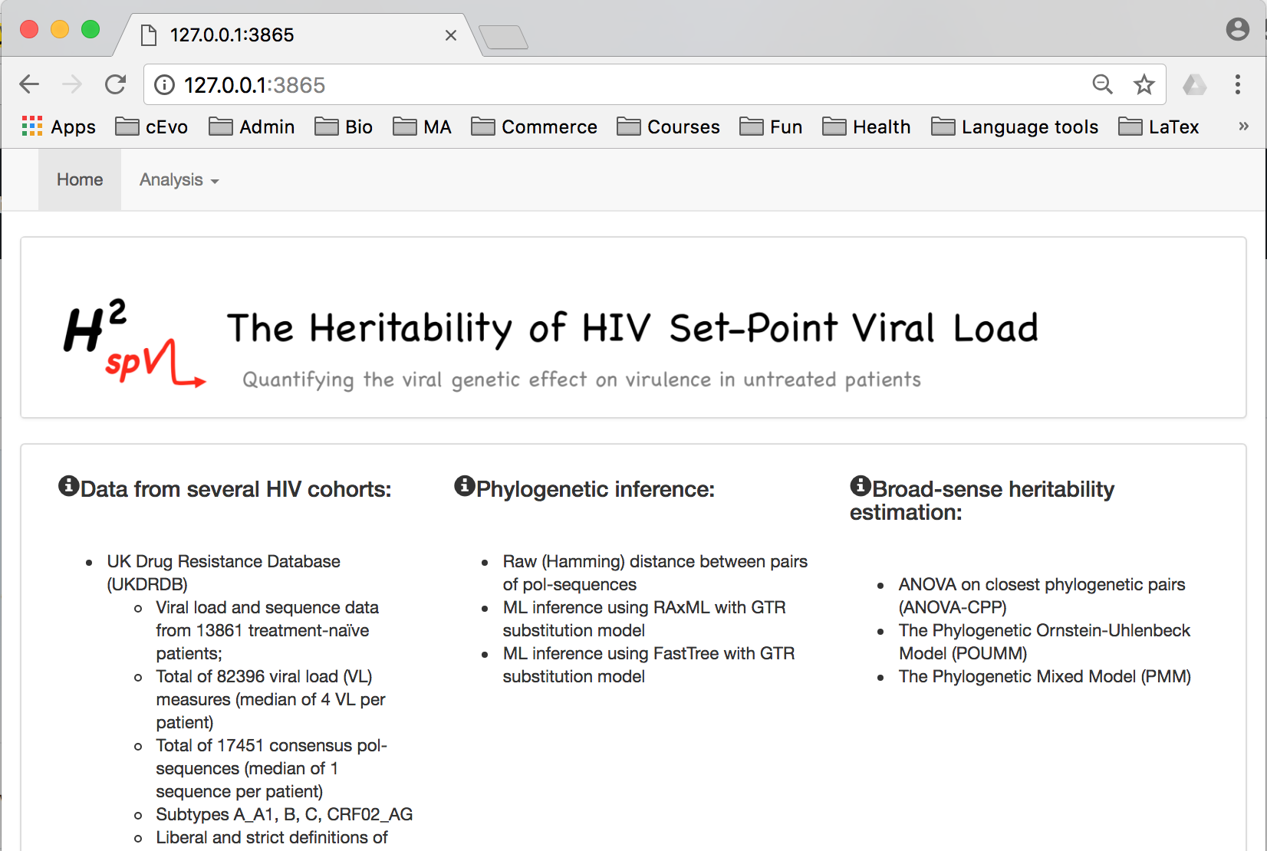
The H2SPVL web-site
Mitov et al. 2018, in preparation

Slide 25
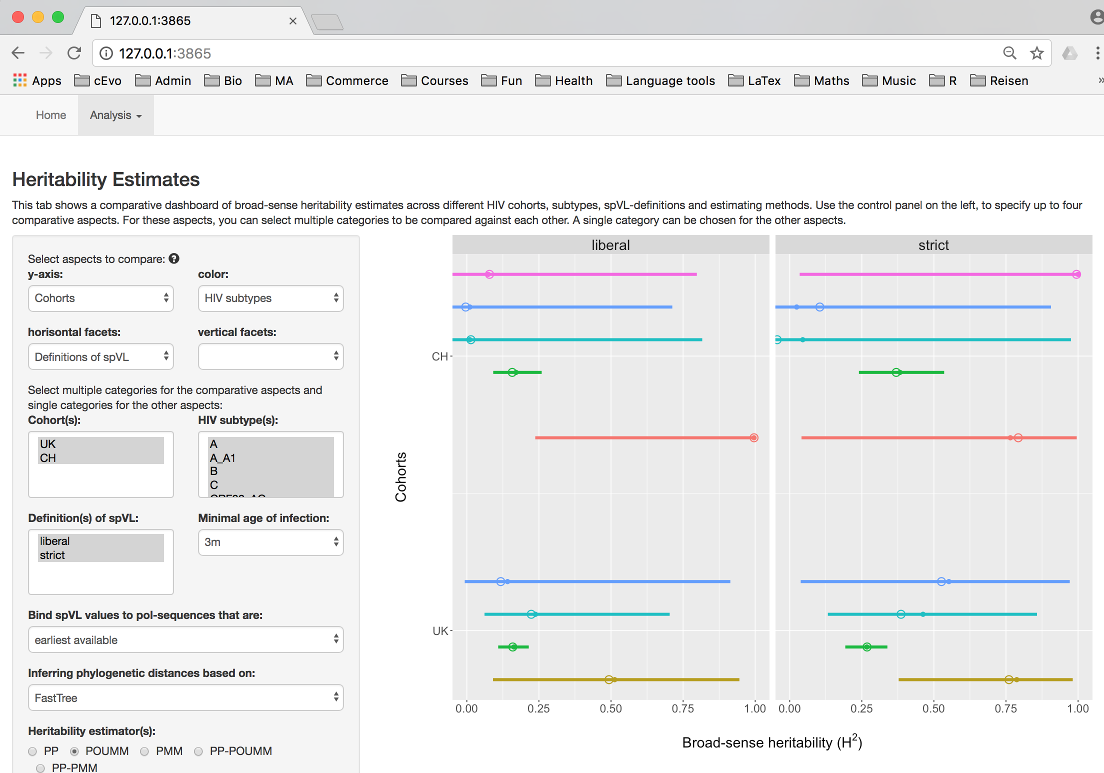
The H2SPVL web-site
Mitov et al. 2018, in preparation

Slide 26
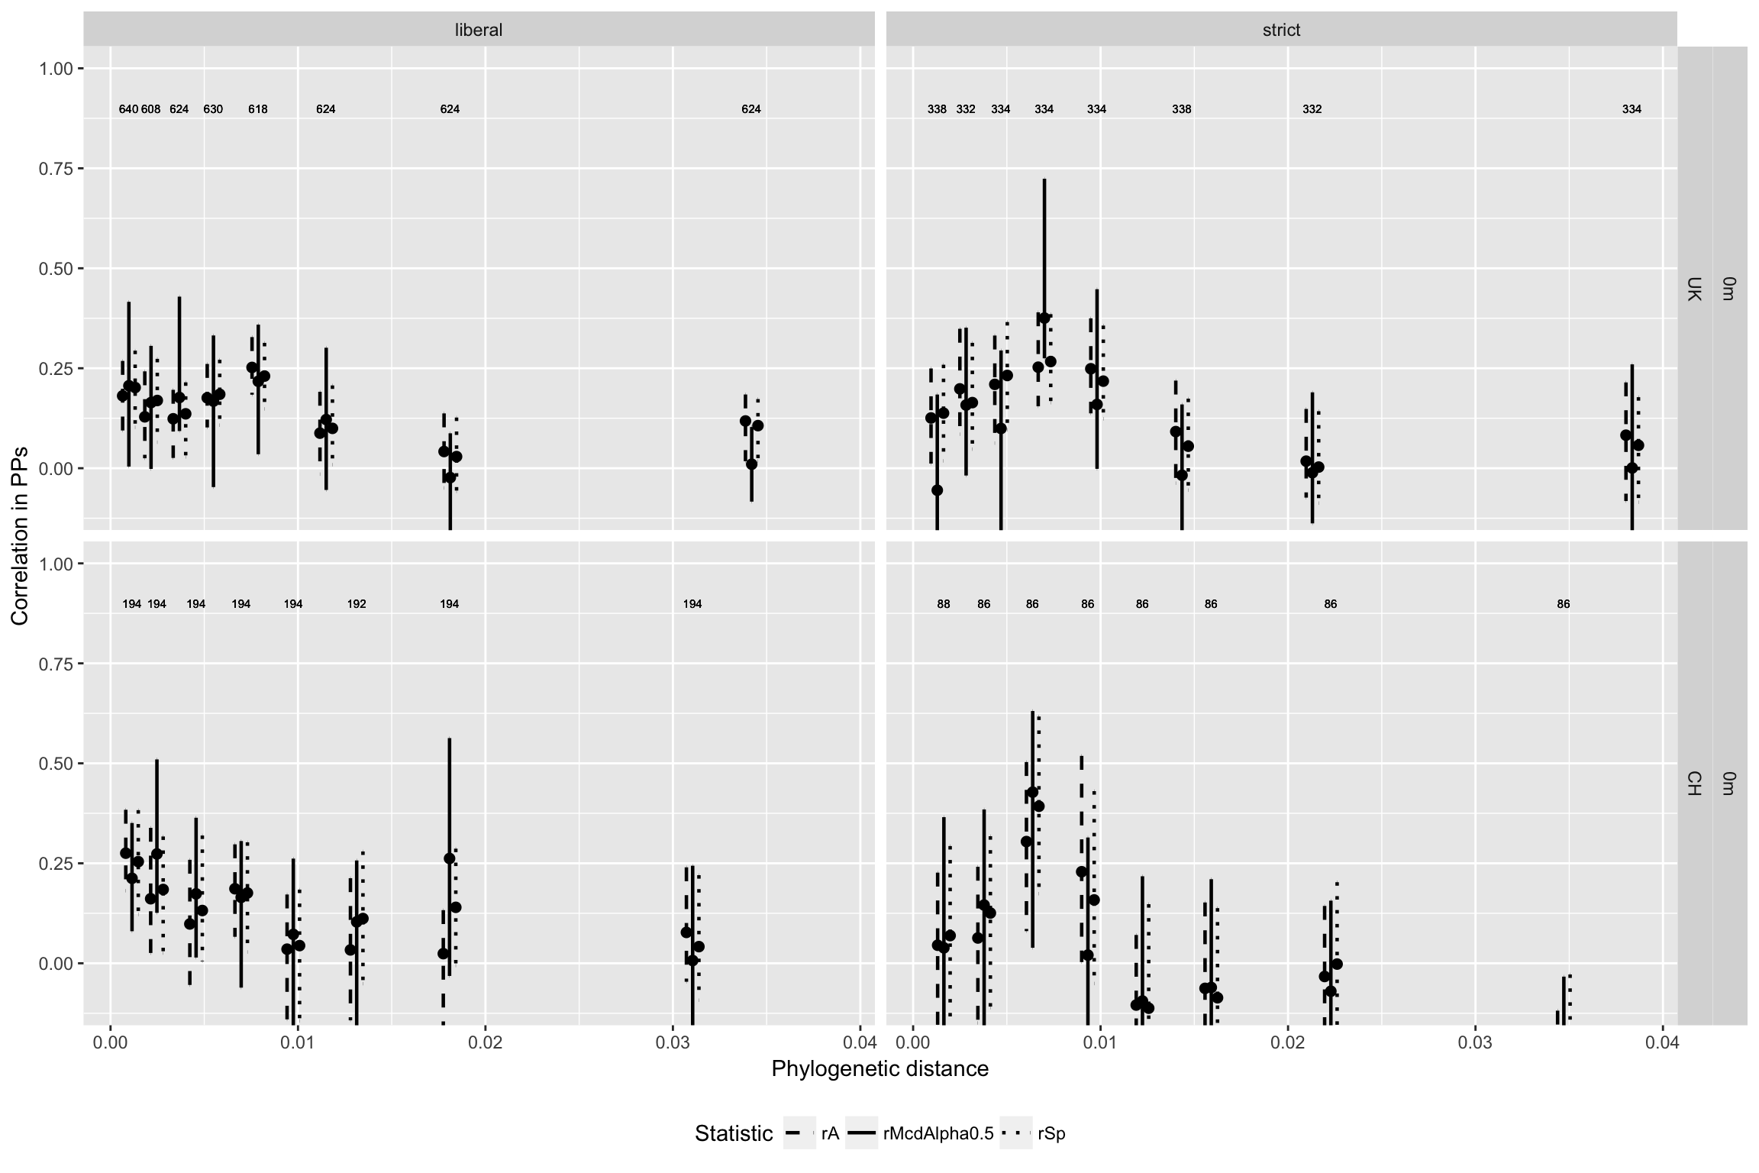
Subtype B, min infection age: 0 months
Mitov et al. 2018, in preparation

Slide 27
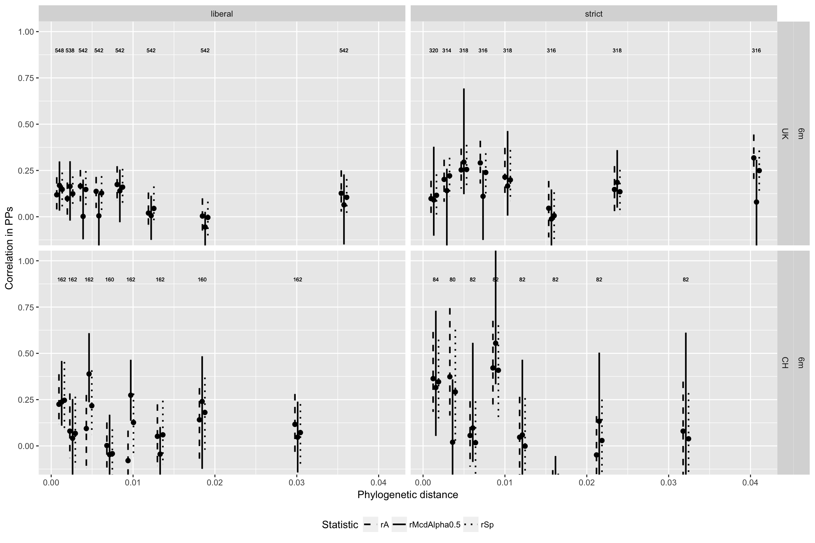
Subtype B, min infection age: 6 months
Mitov et al. 2018, in preparation

Slide 28
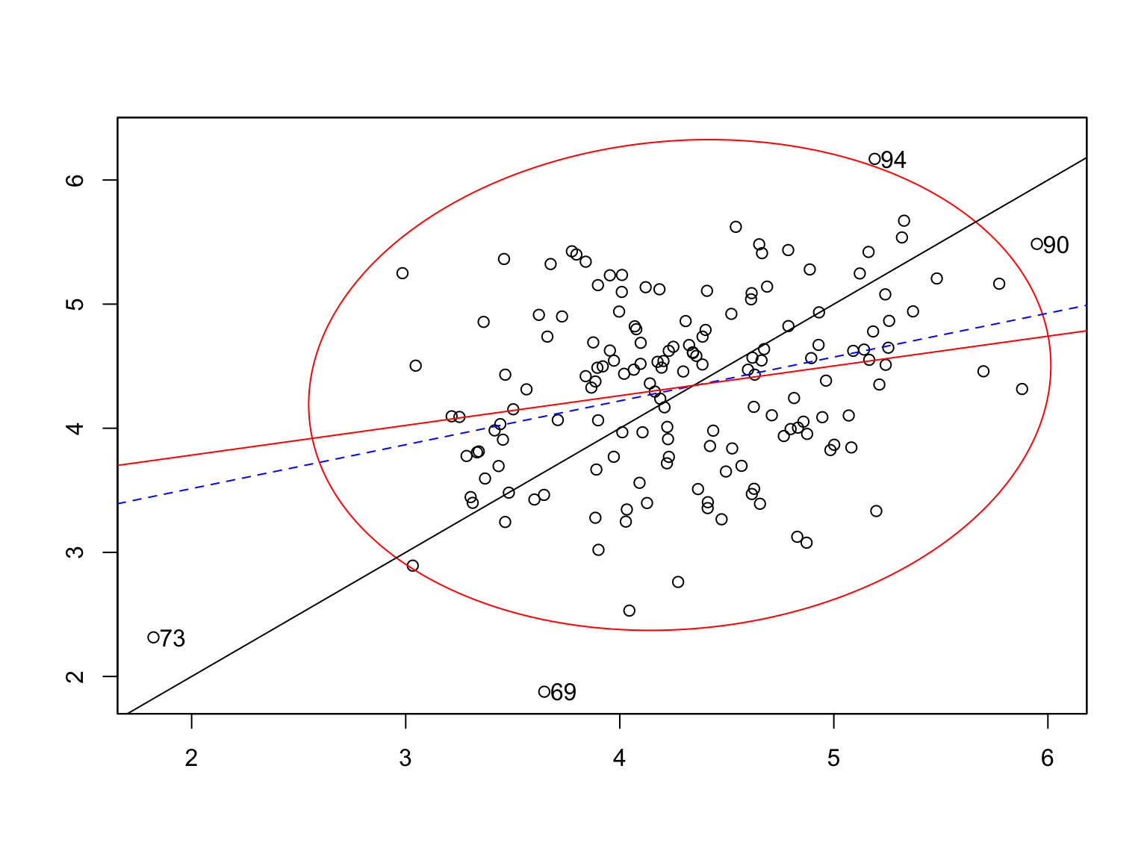
Otlier detection using the MCD method
Scatter plot of PPs in Octile 8 UK/strict/6m:
Mitov et al. 2018, in preparation

Slide 29
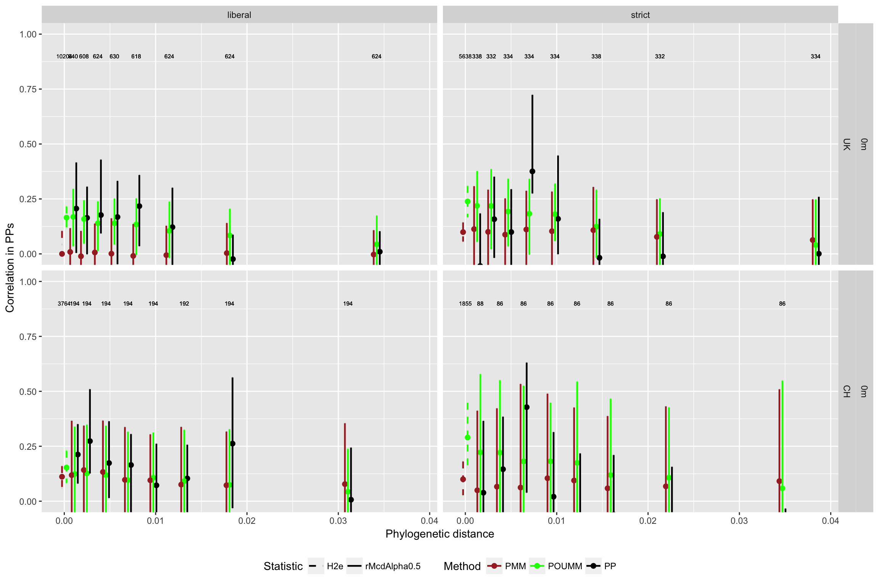
PP vs POUMM vs PMM (0 months)
Mitov et al. 2018, in preparation

Slide 30
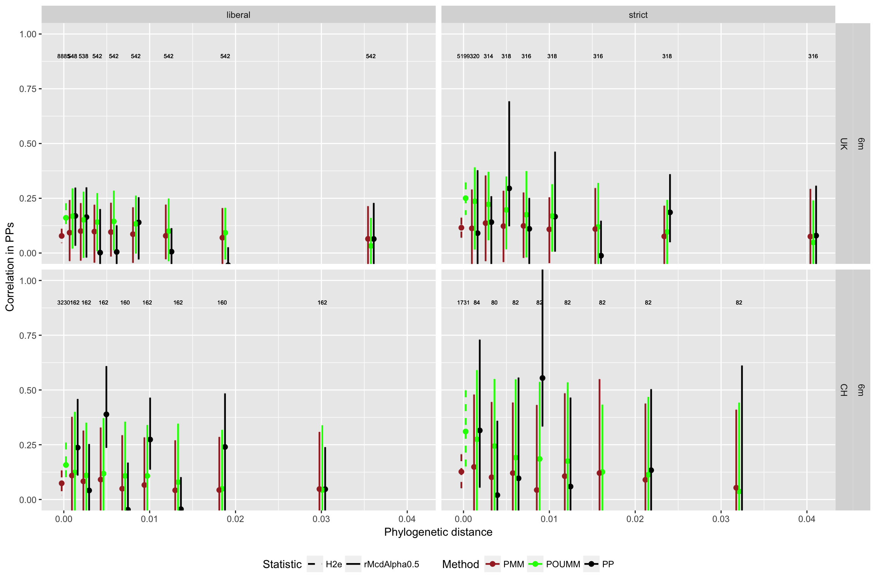
PP vs POUMM vs PMM (6 months)
Mitov et al. 2018, in preparation

Slide 31
Agenda
Definition
Methods
Results from UKDRDB subtype B data
New Results
A toy model of an epidemic
Software

Slide 32
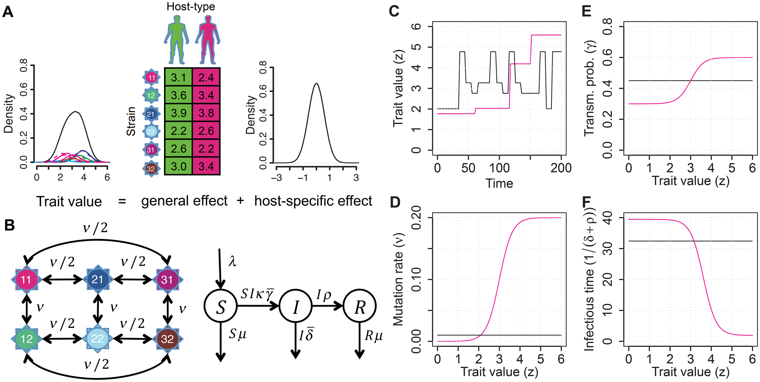
A toy model of an HIV epidemic
Mitov & Stadler 2018, MBE

Slide 33
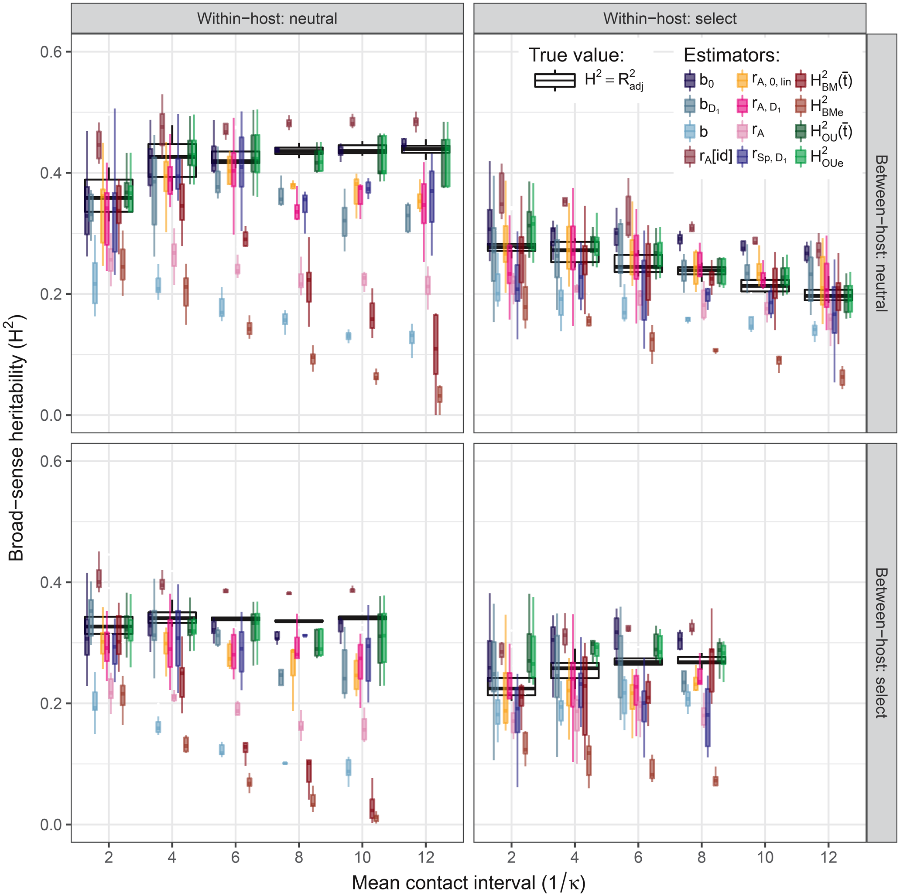
Mitov & Stadler 2018, MBE

Slide 34
Mitov & Stadler 2018, MBE

Slide 35
Agenda
Definition
Methods
Results from UKDRDB subtype B data
New Results
A toy model of an epidemic
Software

Slide 36
Software
R-packages:
POUMM (https://github.com/venelin/POUMM)
Patherit (https://github.com/venelin/patherit)
Toyepidemic (https://github.com/venelin/toyepidemic)
Shiny web-site reporting the combined SHCS + UKDRDB analysis

Slide 37
Conclusions
When accounting for within-host viral mutation, different methods and big cohort studies agree on H² = 0.25 (+/- 0.1) for subtype B populations;
… However, both, donor-recipient regression and phylogenetic mixed models are prone to sampling bias, which can be important in the case of within/between host selection.
The estimate of H² = 0.25 is more likely a lower bound since it neglects the presence of viral quasispecies and transmission bottlenecks.
UK and CH subtype B with strict SPVL definition exhibit a similar pattern of decorrelation between phylogenetic pairs.
… This pattern should be considered with caution since it might be a footprint of sampling bias in the above heritability estimates;
… This pattern cannot be reproduced by current PCM methods (e.g. PMM and POUMM);
… yet it can be reproduced by mechanistic simulations combining within-host and between-host selection with SIR dynamics.
Robust correlation measures such as the MCD and the Spearman’s rank correlation should be given preference to mean product moment estimates (e.g. Pearson’s correlation) to diminish the influence of outliers in the data.

Slide 38

Acknowledgements
ETH Zurich: Tanja Stadler
Data from Hodcroft et al. 2014: Emma Hodcroft and Andrew Leigh Brown;
UK DRDB: Anna Tostevin and David Dunn;
SHCS: Roger Kouyos and Huldrych Günthard.

Slide 39
Mitov & Stadler 2018, MBE

Slide 40
Mitov & Stadler 2018, MBE

Slide 41
Mitov & Stadler 2018, MBE

Slide 42
Mitov & Stadler 2018, MBE

Slide 43
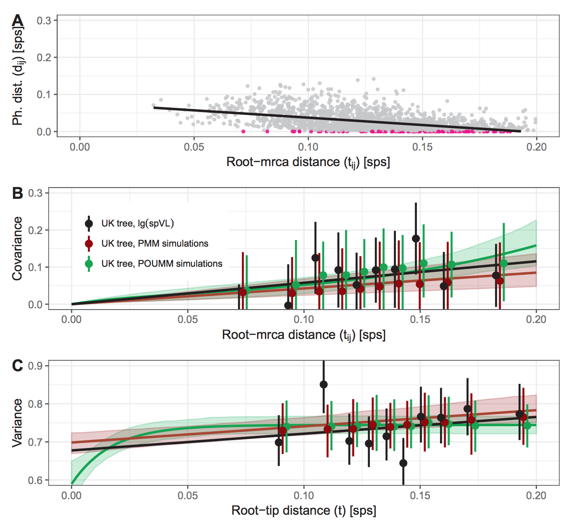
Explaining the bias in PMM

